Slide 1

PCSE214- MOBILE APPLICATION DEVELOPMENT
CHAPTER II
LAYOUTS
By: Mr. Tobias Kakooza.
Professional Certificate in Software Engineering

Slide 2
OBJECTIVES
Understand android layouts
Define layout attributes
Describe features and necessities of a layout
Build responsive UI using different layouts

Slide 3
Views - Overview
The basic building block for user interface is a View object which is created from the View class and occupies a rectangular area on the screen and is responsible for drawing and event handling. View is the base class for widgets, which are used to create interactive UI components like buttons, text fields, etc..

Slide 4
Layouts
Layout basically refers to the arrangement of elements on a page these elements are likely to be images, texts or styles.

Slide 5
Layout Attributes
android:id
This is the ID which uniquely identifies the view
android:layout_width
This is the width of the layout.
android:layout_height
This is the height of the layout
android:layout_gravity
This specifies how child Views are positioned.

Slide 6
View Identification
A view object may have a unique ID assigned to it which will identify the View uniquely within the tree. The syntax for an ID, inside an XML tag is −
android:id="@+id/my_button
Following is a brief description of @ and + signs −
The at-symbol (@) at the beginning of the string indicates that the XML parser should parse and expand the rest of the ID string and identify it as an ID resource.
The plus-symbol (+) means that this is a new resource name that must be created and added to our resources.

Slide 7
Examples of Layouts
The ViewGroup is a subclass of View and provides invisible container that hold other Views or other ViewGroups and define their layout properties. These containers include:
Constraint Layout
Linear Layout
Relative Layout
Frame Layout
Coordinator Layout
List View
Grid View

Slide 8
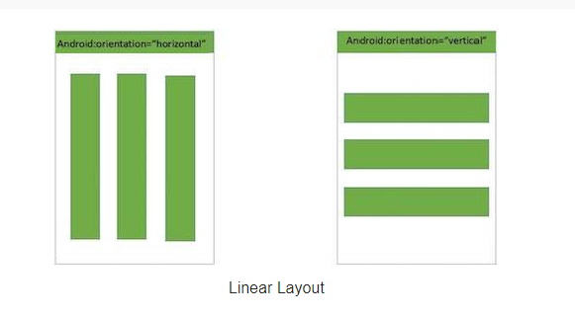
Linear Layout
Android LinearLayout is a view group that aligns all children in either vertically or horizontally.

Slide 9
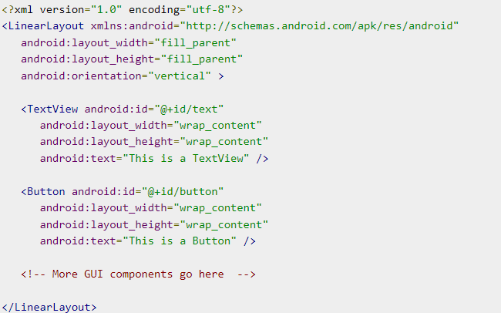
Linear Layout-Snippet

Slide 10
Linear Layout - Attributes
android:id
This is the ID which uniquely identifies the layout.
android:divider
This is drawable to use as a vertical divider between buttons. You use a color value, in the form of "#rgb", "#argb", "#rrggbb", or "#aarrggbb".
android:orientation
This specifies the direction of arrangement and you will use "horizontal" for a row, "vertical" for a column. The default is horizontal.

Slide 11
Linear Layout – Attributes Contd…
android:gravity
This specifies how an object should position its content, on both the X and Y axes. Possible values are top, bottom, left, right, center, center_vertical, center_horizontal etc.

Slide 12
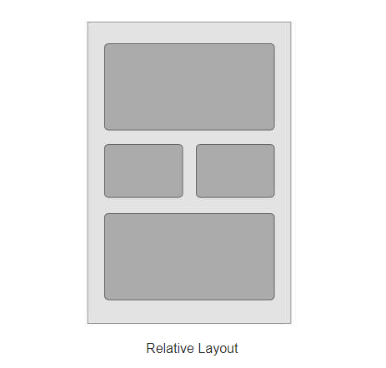
Relative Layout
Android RelativeLayout enables you to specify how child views are positioned relative to each other. The position of each view can be specified as relative to sibling elements or relative to the parent.

Slide 13
WebView Layout
WebView is a view that display web pages inside your application. You can also specify HTML string and can show it inside your application using WebView. WebView makes turns your application to a web application.
In order to add WebView to your application, you have to add <WebView> element to your xml layout file. Its syntax is as follows −

Slide 14
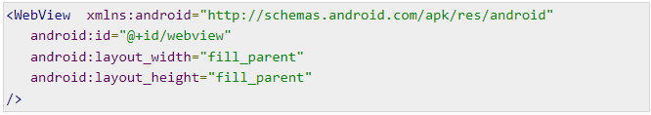
WebView Layout contd…

Slide 15
WebView Layout reference…
In order to use it, you have to get a reference of this view in Java file. To get a reference, create an object of the class WebView. Its syntax is −

Slide 16
WebView Layout loading URL…
In order to load a web url into the WebView, you need to call a method loadUrl(String url) of the WebView class, specifying the required url. Its syntax is:

